Slide 1
ROBOCODE
Simone Conte
(sic2@st-andrews.ac.uk)
(with thanks to Ruth Letham, Shyam Reyal, Greg Bigwood, James Smith,
Andrea Rendl, Kris Getchell, Tim Storer and Martin Bateman)

Slide 2
What is ROBOCODE
Developed by IBM®
Programming game
You develop strategies for your robot
Write Java™ to control your robot

Slide 3
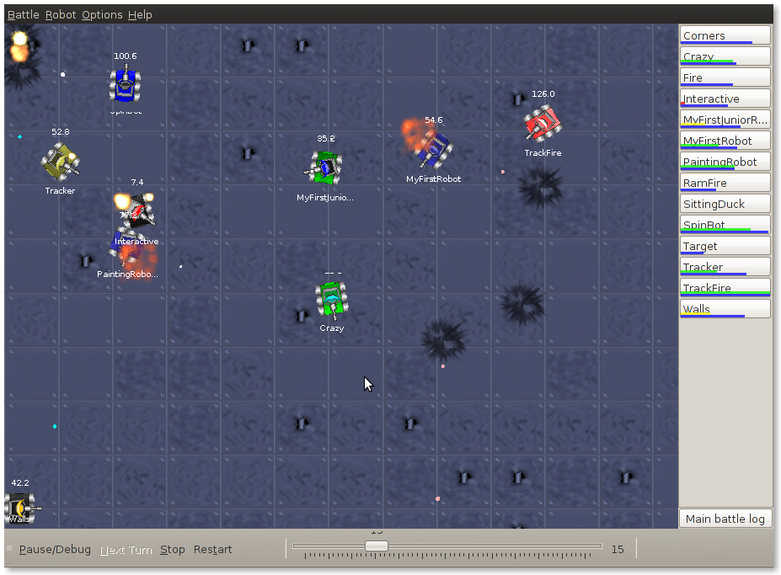

Slide 4

Write code in Java
High-level
Object-Oriented
Case-sensitive (Foo, foo, FOO)
“Write once, run anywhere”

Slide 5
Write code in Java
Java code for your robot
package & import
comments ( /* ABC */ or // XYZ on one line)
robot definition
run
onScannedRobot - what to do when you see a robot
onHitByBullet - what to do when you are shot
onHitWall - what to do if you bump into a wall
Edit the program
change name of the author in the comment

Slide 6
Change the color of your robot
import java.awt.Color;
setColors(Color bodyColor, Color gunColor, Color radarColor)
setColors(Color bodyColor, Color gunColor, Color radarColor, Color bulletColor, Color scanArcColor)
Example
public void run() {
setColors(Color.ORANGE, Color.YELLOW, Color.GREEN);
}

Slide 7
Moving
Movement is controlled by ahead() and back()
Direction of travel is controlled by turnLeft() and turnRight()
Direction of the gun is controlled by turnGunLeft() and turnGunRight()

Slide 8
Moving
Movement is controlled by ahead() and back()
Direction of travel is controlled by turnLeft() and turnRight()
Direction of the gun is controlled by turnGunLeft() and turnGunRight()
Need to know how far to move (pixels) or turn (degrees)
This code makes the robot:
moveforward
spin around clockwise
move backwards
spin its gun counter-clockwise
ahead(100); turnRight(360)
back(50);
turnGunLeft(360);

Slide 9
Shooting
Shooting is controlled by fire()
When you see a robot an event is triggered
onScannedRobot() is executed
public void onScannedRobot(ScannedRobotEvent e) {
fire(1);
}
public void onScannedRobot(ScannedRobotEvent e) {
fire(1.5); // MAX is 3
}

Slide 10
Shooting
Shooting is controlled by fire()
When you see a robot an event is triggered
onScannedRobot() is executed
Want to pack more of a punch?
public void onScannedRobot(ScannedRobotEvent e) {
fire(1);
}
public void onScannedRobot(ScannedRobotEvent e) {
fire(10); // This will be equal to fire(3);
}

Slide 11
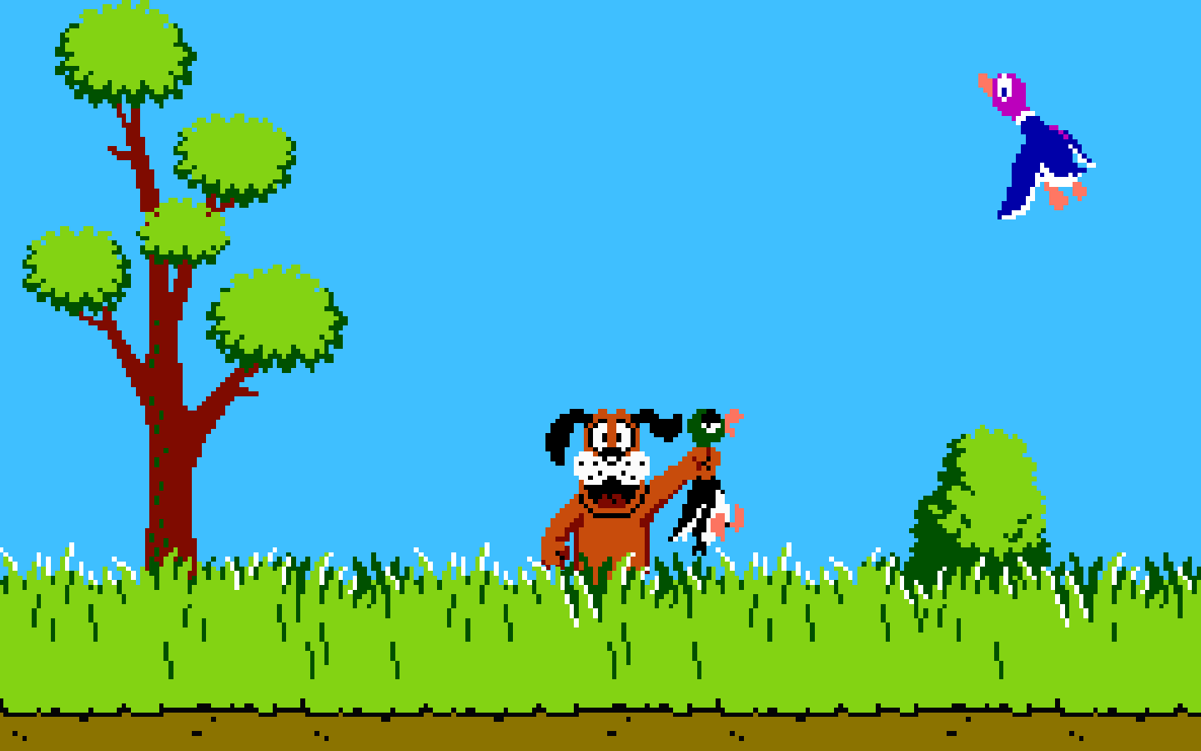
Shooting
Be Careful!
Firing costs energy
No energy = Sitting Duck!
Shooting is controlled by fire()
When you see a robot an event is triggered
onScannedRobot() is executed
Want to pack more of a punch?
public void onScannedRobot(ScannedRobotEvent e) {
fire(1);
}
public void onScannedRobot(ScannedRobotEvent e) {
fire(10);
}

Slide 12
Shooting
The more you shoot, the more power is spend
(4 * power) damage if it hits another robot.
If power is greater than 1, it will do an additional 2 * (power - 1) damage.
You will get (3 * power) back if you hit the other robot.

Slide 13
Taking Fire
If you are dishing it out, you are probably going to take some hits too
When your robot gets shot, another event is triggered
onHitByBullet() is executed

Slide 14
Taking Fire
If you are dishing it out, you are probably going to take some hits too
When your robot gets shot, another event is triggered
onHitByBullet() is executed
Try changing your direction by a fixed amount and moving away
public void onHItByBullet(HitByBulletEvent e) {
turnLeft(90);
back(100);
}

Slide 15
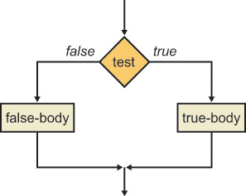
If … else Conditions
Used to make Boolean (true/false) decisions in code
do one thing, or another thing depending on a condition
Basic Structures
if (<condition>) {
// code
}
if (<condition>) {
// code
}
else {
// code
}

Slide 16
If … else Conditions
Used to make Boolean (true/false) decisions in code
do one thing, or another thing depending on a condition
Basic Structures
Condition is enclosed in parentheses ()
Action is enclosed in braces {}
Use ! (NOT), && (AND) and || (OR) to make more complex conditions
if (<condition>) {
// code
}
if (<condition>) {
// code
}
else {
// code
}

Slide 17
Example
Strategy: When I see an enemy, it is close by and I have lots of energy fire hard at it, otherwise just fire a basic shoot

Slide 18
Example
Strategy: When I see an enemy, it is close by and I have lots of energy fire hard at it, otherwise just fire a basic shoot
When onScannedRobot is executed
e contains information about the robot we scanned
Get the distance of the scanned robot with e.getDistance()
Get energy of my robot with getEnergy()
public void onScannedRobot(ScannedRobotEvent e) {
if (e.getDistance() < 50 && getEnergy() > 50) {
fire(3);
} else {
fire(1);
}
}

Slide 19
Variables
You can also make use of variables
public void onScannedRobot(ScannedRobotEvent e) {
double myEnergy = getEnergy();
double enemyDistance = e.getDistance();
if (enemyDistance < 50 && myEnergy > 50) {
fire(3);
} else {
fire(1);
}
if (myEnergy > 40) {
turnLeft(120);
fire(2);
}
}

Slide 20
Example 2: Shooting
You cannot fire if your gun is overheated
if (getGunHeat() == 0) {
fire(Rules.MAX_BULLET_POWER);
}

Slide 21
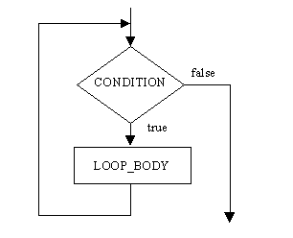
While Loops
Repeat a block of code any number of times while a condition holds
Basic Structure
while (<condition>) {
// code
}

Slide 22
While Loops
Repeat a block of code any number of times while a condition holds
Basic Structure
Condition is enclosed in parentheses ()
Action is enclosed in braces {}
Use ! (NOT), && (AND) and || (OR) to make more complex conditions
Example:
while (<condition>) {
// code
}
while (getEnergy() > 90) {
fire(1);
}
double myEnergy = getEnergy();
while (myEnergy > 90) {
fire(1);
}

Slide 23
Java Coding
Java is case sensitive
getenergy() is not the same as getEnergy()

Slide 24
Java Coding
Java is case sensitive
getenergy() is not the same as getEnergy()
White space does not change the meaning of your code, but can make it easier to read (i.e. if (condition) is the same as if(condition))

Slide 25
Java Coding
Java is case sensitive
getenergy() is not the same as getEnergy()
White space does not change the meaning of your code, but can make it easier to read (i.e. if (condition) is the same as if(condition))
Parentheses () and braces {} always come in pairs
An open parenthesis ( must have a matching closing parenthesis )
An open brace { must have a matching closing brace }

Slide 26
Java Coding
Java is case sensitive
getenergy() is not the same as getEnergy()
White space does not change the meaning of your code, but can make it easier to read (i.e. if (condition) is the same as if(condition))
Parentheses () and braces {} always come in pairs
An open parenthesis ( must have a matching closing parenthesis )
An open brace { must have a matching closing brace }
Instruction statements must end with semicolon ;
fire(1);
getDistance();

Slide 27
Java Coding
Parentheses enclose conditions in an if-statement or while statement
if (<condition>)
while (<condition>)

Slide 28
Java Coding
Parentheses enclose conditions in an if-statement or while statement
if (<condition>)
while (<condition>)
Parentheses enclose the information needed for a method
fire(1)
getEnergy()

Slide 29
Java Coding
Parentheses enclose conditions in an if-statement or while statement
if (<condition>)
while (<condition>)
Parentheses enclose the information needed for a method
fire(1)
getEnergy()
Braces mark the start and end of a section of code
public void run() { … }
if (<condition>) { … } else { … }
while (<condition>) { … }

Slide 30
Programming Hints
If you do not know how to do something:
Dabble with the code - you might work out the solution by accident!
Use the notes provided for commands to the robots, scanning, shooting, turning, etc…
Ask the demonstrators in the Lab
Have a look on the internet
Google
http://robocode.sourceforge.net (good resource for code)
API: http://robocode.sourceforge.net/docs/robocode/
http://www.ibm.com/developerworks/library/j-tipstrats/
Boolean Algebra
http://law.lclark.edu/live/files/9385-boolean-basics

Slide 31
More resources
Some more useful info on Robocode: https://sic2.host.cs.st-andrews.ac.uk/robocode-extra.html
Some basic info on java: https://sic2.host.cs.st-andrews.ac.uk/basic-java.html https://learnxinyminutes.com/docs/java/

Slide 32
Design a Strategy
Decide on your strategy and tactics
Choose your overall strategy
Aggressive - seek and destroy
Defensive - back to the wall/find a corner
Neutral - patrol route

Slide 33
Design a Strategy
Decide on your strategy and tactics
Choose your overall strategy
Aggressive - seek and destroy
Defensive - back to the wall/find a corner
Neutral - patrol route
What events do you want to react to?
See an enemy, hit a wall, hit an enemy, hit by a bullet, etc…

Slide 34
Design a Strategy
Decide on your strategy and tactics
Choose your overall strategy
Aggressive - seek and destroy
Defensive - back to the wall/find a corner
Neutral - patrol route
What events do you want to react to?
See an enemy, hit a wall, hit an enemy, hit by a bullet, etc…
How do you want to react to them?
Shoot, turn, move?

Slide 35
Design a Strategy
Decide on your strategy and tactics
Choose your overall strategy
Aggressive - seek and destroy
Defensive - back to the wall/find a corner
Neutral - patrol route
What events do you want to react to?
See an enemy, hit a wall, hit an enemy, hit by a bullet, etc…
How do you want to react to them?
Shoot, turn, move?
Writing your overall strategy and individual tactics down in English before you start to code will help you later

Slide 36
Building your Robot
Build your robot step-by-step
Choose one tactic to start with:
Write the code
Fix any errors displayed
Test your robot against the sample robots
Check the robot is behaving as expected
Make any changes or improvements
Do this for each tactic until you have built your entire strategy

Slide 37
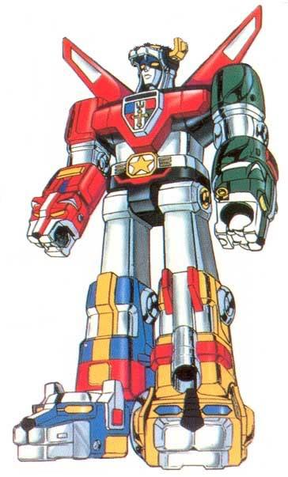
Create your new Awesome Robot!
From the Editor
File → New → Robot
Name your robot (has to start with a capital case)
Package name: django
Remember to write the author of the robot in the comment
/**
* Franky - a robot by Simone Conte
*/

Slide 38
Starting a Battle
From the menu bar, choose: Battle → New
In the dialog box that appears:
click on button marked Add All
click on button marked Next
Set Number of Rounds to 1
Battlefield size using buttons on the right
1000x1000 is a good size
Click the Start Battle button to the being the WAR!

Slide 39
Q/A
Q: My robot is not winning with the highest score, even though it is the only one left on the battlefield. Why is that the case?
A: A robot that does not fire much, but "just" saves its energy is getting a lesser score than a robot that hits other robots with a lot of bullets.
Q: How fast does a bullet travel?
A: A bullet travels at a speed between 11.0 and 19.7 depending on the power. The more powerful the bullet, the slower. The formula to calculate it is velocity = 20 - (3 * power)
Q: Which is the range of a bullet?
A: A bullet has no range. It keeps going until it hits a robot or a wall.

Slide 40
Rest of Session
For the next 30 minutes
Design & build your robot
Use the slides, handout & online resources for programming tips
API Documentation accessible from Robot Editor/Help → Robocode API
Handout contains
a list of methods you are likely to use
example code showing loops, conditional statements, etc.
We will be around to help.
If you want to run something by us, put up your hand.
For the last 15 minutes
Your robots will compete against each other on the big screen!

